Slide 1
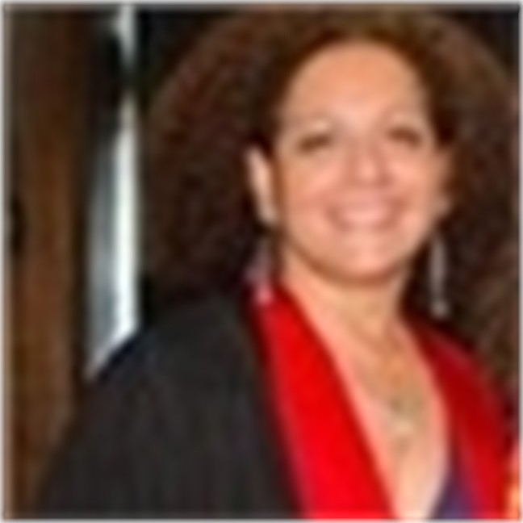
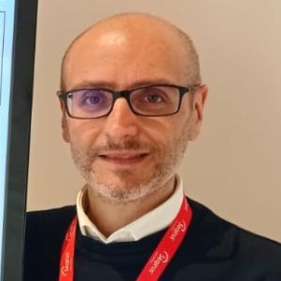
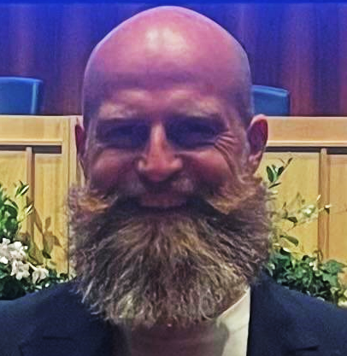
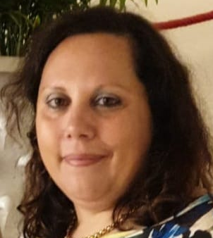
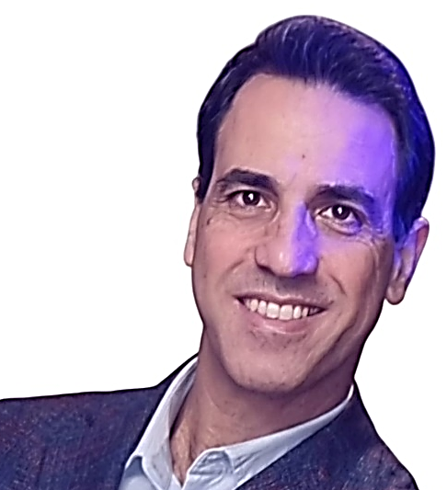
UniMe-IMS Management Staff
Coordinator: Prof. Daniela Caccamo
e-mail: master.medicinesurgery@unime.it
(for any request of either exam or ECTS recognition or certificate validation);
daniela. caccamo@unime.it (for any request of appointment for personal issues)
Vice-Coordinator: Prof Alessio Facciolà
e-mail: master.medicinesurgery@unime.it
(for any request of either exam or ECTS recognition or certificate validation)
alessio. facciola@unime.it (for request of appointment for personal issues)
Persons in charge of the Didactic Secretary:
Dr Massimo Brigandì, Dr Vincenza Santoro
e-mail: master.medicinesurgery@unime.it;
massimo.brigandì@unime.it; vincenza.santoro@unime.it
Head of the Medical Secretary Unit: Dr Alfonso De Salvo
e-mail: alfonso.desalvo@unime.it; uop1medsanvet@unime.it
(for any administrative issue)

Slide 2
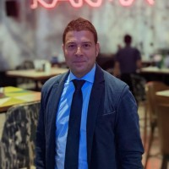
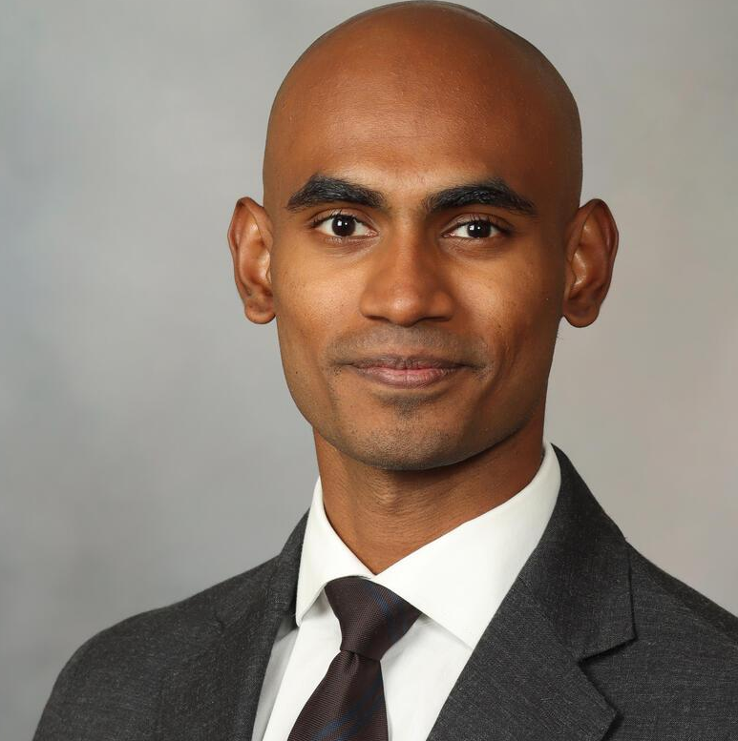

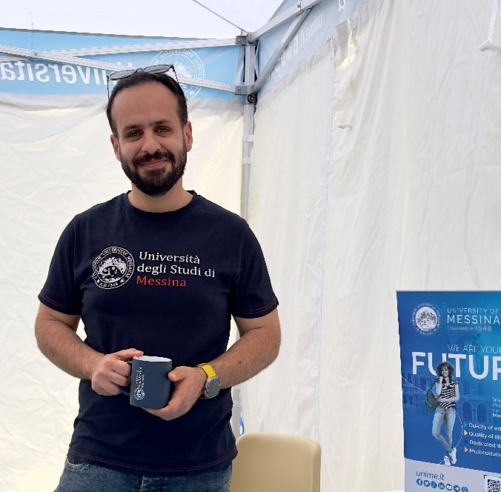
Welcome Office (Head: Dr Giuseppe Lucchese)
e-mail: foreignstudents@unime.it; uopwelcomeoffice@unime.it
For information regarding IMAT, pre-enrolment and enrolment procedures and other administrative issues
Welcome Point Network
Welcome Point + Ambassador Student Program
Coordinator of Ambassador Students: Raouf Mastan
e-mail: abdulraouf.mastansheikabdullah@unime.it
Welcome Point Ambassador Student:
Suresh Yaddla
e-mail: sureshkumar.yaddla@unime.it
Medical Campus Ambassador Student:
Akbar Tehrani
E-mail: akbar.azaditehrani@studenti.unime.it

Slide 3

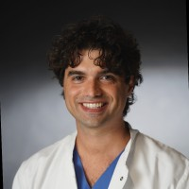
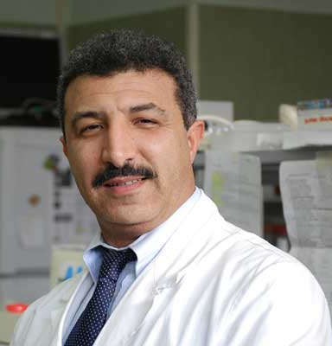
Contact person for Guidance and Tutoring
Prof. Tommaso D’Angelo
e-mail: tommaso.dangelo@unime.it
Prof. M'Hammed Aguennouz
e-mail: aguenoz.mhommed@unime.it
All Professors:
https://medicine-and- surgery.cdl.unime.it/en/studying/professors
Contact person for International Mobility
Use your institutional e-mail
address to contact them!

Slide 4


Commission For Technical-pedagogical Programming
Coordinator
Vice-Coordinator
7 Teachers
2 students representatives (Maria Paola Caroli, Martina De Salvo)
1 administrative technician (Dr Enza Santoro)
TASKS
Setting of learning goals and contents of teaching activities
Yearly and cyclic evaluation of Course performance (quality of teaching activities, n° of newly enrolled students/year, ECTS achieved/year, rate of international mobility etc)
Recognition of exams, credits and certificates

Slide 5



Dr Giacomo Caudo, President of Order of Physicians, Surgeons, Dentists of Messina (OMCEO-ME); President of Federation of Italian General Practitioners
Dr Salvatore Amato, President of Order of Physicians, Surgeons, Dentists of Palermo (OMCEO-PA); Vice-President of Conférence des Ordres des Médicins Euro Méditerranées
Dr Giuseppe Murolo, Health Director of Polyclinic University Hospital, ME
Dr Marcello Nucifora, Health Director of IRCCS Neurolesi, ME
Dr Giuseppe Ranieri Trimarchi, Health Director of ASP, ME
Dr Basilia Zingarelli, Pediatrician, Director of Critical Care Basic Science Research, Cincinnati Children’s Hospital Medical Center, Cincinnati, Ohio (US)
Prof Rodolfo Savica, Neurologist, Mayo Foundation for Medical Education and Research, Rochester, Minnesota (US)
Dr Simona Calabrese, Resident in Legal Medicine, University of Messina

